Slide 1

DDS / PLL
DIC 5HEL / Version 1 / LAP

Slide 2
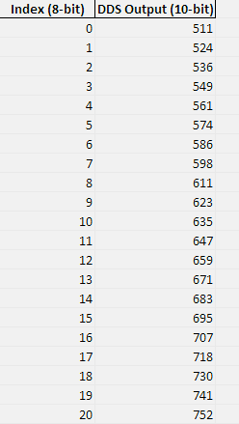
Direct Digital Synthesizer (DDS)
8 bit Index
10 bit Auflösung

Slide 3
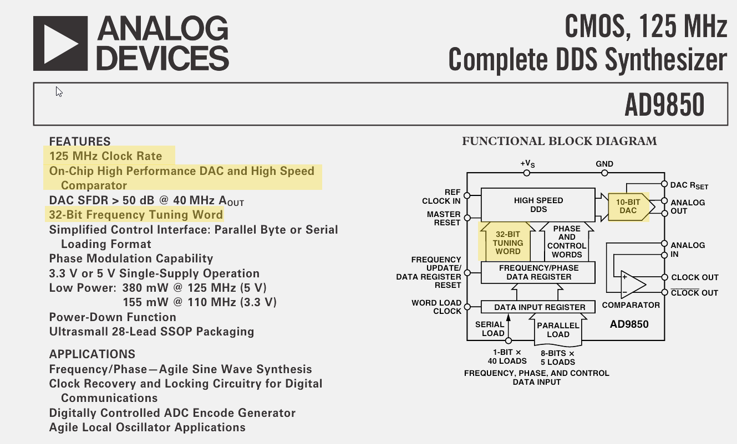

Direct Digital Synthesizer (DDS)
$$FTW=\frac{f_{out} ∗2^{N}}{f_{clk}}$$
FTW … Frequency Tuning Word
f_{clk} … system clock
f_{out} … desired output frequency 2^{N} … resolution of phase accumulator

Slide 4
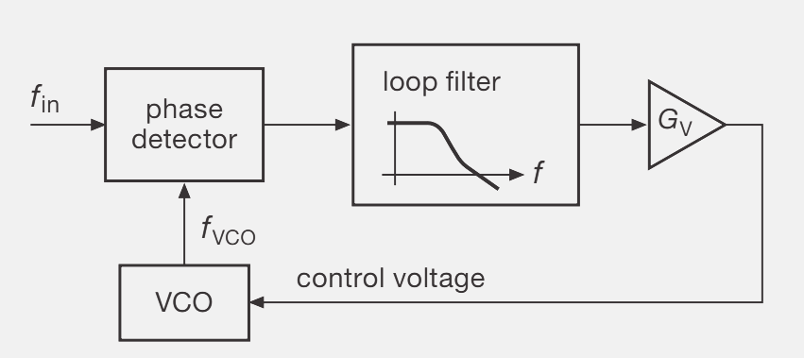
Phase Locked Loop (PLL)
:N

